Slide 1

C++ How to Program: Introducing the New C++14 Standard
Tenth Edition
Chapter 9
Classes: A Deeper Look
Copyright © 2017, 2014, 2012 Pearson Education, Inc. All Rights Reserved
Notes:
If this PowerPoint presentation contains mathematical equations, you may need to check that your computer has the following installed:
1) MathType Plugin
2) Math Player (free versions available)
3) NVDA Reader (free versions available)

Slide 2
Learning Objectives ( 1 of 2)
Engineer a class to separate its interface from its implementation and encourage reuse
Access class members via an object’s name or a reference using the dot (.) operator.
Access class members via a pointer to an object using the arrow (->) operator.
Use destructors to perform “termination housekeeping.”
Learn the order of constructor and destructor calls.
Learn about the dangers of returning a reference or a pointer to private data.

Slide 3
Learning Objectives ( 2 of 2)
Assign the data members of one object to those of another object.
Create objects composed of other objects.
Use friend functions and learn how to declare friend classes.
Use the this pointer in a member function to access a non-static class member.
Use static data members and member functions.

Slide 4
Outline (1 of 6)
9.1 Introduction
9.2 Time Class Case Study: Separating Interface from Implementation
9.2.1 Interface of a Class
9.2.2 Separating the Interface from the Implementation
9.2.3 Time Class Definition
9.2.4 Time Class Member Functions
9.2.5 Scope Resolution Operator (::)
9.2.6 Including the Class Header in the Source-Code File

Slide 5
Outline (2 of 6)
9.2.7 Time Class Member Function setTime and Throwing Exceptions
9.2.8 Time Class Member Function to UniversalString and String Stream Processing
9.2.9 Time Class Member Function toStandardString
9.2.10 Implicitly Inlining Member Functions
9.2.11 Member Functions vs. Global Functions
9.2.12 Using Class Time
9.2.13 Object Size

Slide 6
Outline (3 of 6)
9.3 Compilation and Linking Process
9.4 Class Scope and Accessing Class Members
9.5 Access Functions and Utility Functions
9.6 Time Class Case Study: Constructors with Default Arguments
9.6.1 Constructors with Default Arguments
9.6.2 Overloaded Constructors and C++11 Delegating Constructors
9.7 Destructors

Slide 7
Outline (4 of 6)
9.8 When Constructors and Destructors Are Called
9.8.1 Constructors and Destructors for Objects in Global Scope
9.8.2 Constructors and Destructors for Non-static Local Objects
9.8.3 Constructors and Destructors for static Local Objects
9.8.4 Demonstrating When Constructors and Destructors Are Called

Slide 8
Outline (5 of 6)
9.9 Time Class Case Study: A Subtle Trap—Returning a Reference or a Pointer to a private Data Member
9.10 Default Memberwise Assignment
9.11 const Objects and const Member Functions
9.12 Composition: Objects as Members of Classes
9.13 friend Functions and friend Classes
9.14 Using the this Pointer
9.14.1 Implicitly and Explicitly Using the this Pointer to Access an Object’s Data Members

Slide 9
Outline (6 of 6)
9.14.2 Using the this Pointer to Enable Cascaded Function Calls
9.15 static Class Members
9.15.1 Motivating Classwide Data
9.15.2 Scope and Initialization of static Data Members
9.15.3 Accessing static Data Members
9.15.4 Demonstrating static Data Members
9.16 Wrap-Up

Slide 10
9.1 Introduction (1 of 3)
This chapter takes a deeper look at classes.
Coverage includes:
Using an include guard in a header to prevent header code from being included in the same source code file more than once.
Using an ostringstream to create string representations of objects.
An overview of the compile/link process.
Accessing object members via the object’s name, a reference to an object and a pointer to an object.
Access functions that can read or write an object’s data members.

Slide 11
9.1 Introduction (2 of 3)
Utility functions—private member functions that support the operation of the class’s public member functions.
How default arguments can be used in constructors.
Destructors that perform “termination housekeeping” on objects before they’re destroyed.
The order in which constructors and destructors are called.
How returning a reference or pointer to private data breaks the encapsulation of a class, allowing client code to directly access an object’s data.
Default memberwise assignment to assign an object of a class to another object of the same class.

Slide 12
9.1 Introduction (3 of 3)
const objects and const member functions to prevent modifications of objects and enforce the principle of least privilege.
Composition—a form of reuse in which a class can have objects of other classes as members.
Friendship to specify that a nonmember function can also access a class’s non-public members—a technique that’s often used in operator overloading for performance reasons.
this pointer, which is an implicit argument in all calls to a class’s non-static member functions, allowing them to access the correct object’s data members and non-static member functions.

Slide 13
9.2 Time Class Case Study (1 of 2)
Prior class-definition examples placed a class in a header for reuse, then included the header into a source-code file containing main
Reveals the entire implementation of the class to the class’s clients
Client code (e.g., main) needs to know only
what member functions to call
what arguments to provide to each member function, and
what return type to expect from each member function.

Slide 14
9.2 Time Class Case Study (2 of 2)
The client code does not need to know how those functions are implemented.
If client code does know how a class is implemented, the programmer might write client code based on the class’s implementation details.
If an implementation changes, the class’s clients should not have to change.
Hiding the class’s implementation details makes it easier to change the class’s implementation while minimizing, and hopefully eliminating, changes to client code.

Slide 15
9.2.1 Interface of a Class (1 of 2)
Interfaces define and standardize the ways in which things such as people and systems interact with one another
A radio’s controls serve as an interface between the radio’s users and its internal components.
The controls allow users to perform a limited set of operations (such as changing the station, adjusting the volume, and choosing between A M and F M stations)
Various radios may implement these operations differently—some provide push buttons, some provide dials and some support voice commands

Slide 16
9.2.1 Interface of a Class (2 of 2)
The interface specifies what operations a radio permits users to perform but does not specify how the operations are implemented inside the radio.
Interface of a class describes what services a class’s clients can use and how to request those services, but not how the class carries out the services
A class’s public interface consists of the class’s public member functions (also known as the class’s public services)
You can specify a class’s interface by writing a class definition that lists only the class’s member-function prototypes and the class’s data members

Slide 17
9.2.2 Separating the Interface from the Implementation (1 of 2)
To separate the class’s interface from its implementation, we break up class Time into
header Time.h (Figure 9.1) in which class Time is defined, and
source-code file Time.cpp (Figure 9.2) in which Time’s member functions are defined
Benefits
The class is reusable
The clients of the class know what member functions the class provides, how to call them and what return types to expect, and

Slide 18
9.2.2 Separating the Interface from the Implementation (2 of 2)
the clients do not know how the class’s member functions are implemented
By convention, member-function definitions are placed in a source-code file of the same base name (e.g., Time) as the class’s header but with a .cpp filename extension
The source-code file in Figure 9.3 defines function main (the client code).
Section 9.3 shows a diagram and explains how this three-file program is compiled from the perspectives of the Time class programmer and the client-code programmer—and what the Time application user sees.

Slide 19
9.2.3 Time Class Definition (1 of 4)
The header Time.h (Figure 9.1) contains Time’s class definition
Function prototypes (lines 13–15) describe the class’s public interface without revealing the member-function implementations
The function prototype in line 13 indicates that setTime requires three int parameters and returns void
The prototypes for member functions toUniversalString and toStandardString (lines 14–15) each specify that the function takes no arguments and returns a string.

Slide 20
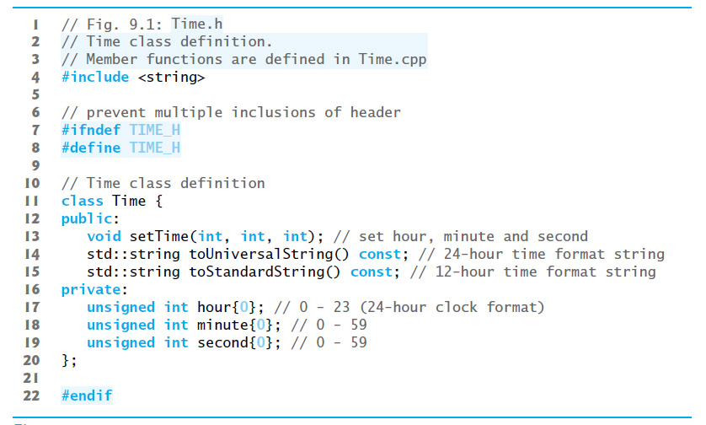
Figure 9.1 | Time Class Definition

Slide 21
9.2.3 Time Class Definition (2 of 4)
The header still specifies the class’s private data members (lines 17–19)
each uses a C++11 in-class list initializer to set the data member to 0
Compiler must know the data members of the class to determine how much memory to reserve for each object of the class
Including the header Time.h in the client code (line 6 of Figure 9.3) provides the compiler with the information it needs to ensure that the client code calls the member functions of class Time correctly.

Slide 22
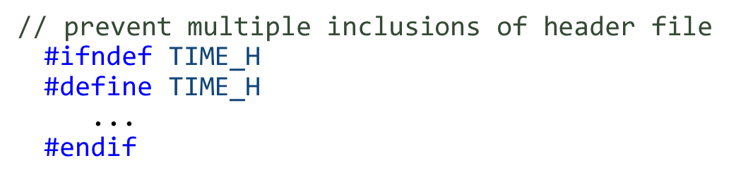
9.2.3 Time Class Definition (3 of 4)
In Figure 9.1, the class definition is enclosed in the following include guard:
Prevents the code between #ifndef (which means “if not defined”) and #endif from being #included if the name TIME_H has been defined
When Time.h is #included the first time, the identifier TIME_H is not yet defined

Slide 23
9.2.3 Time Class Definition (4 of 4)
#define directive defines TIME_H and the preprocessor includes the Time.h header’s contents in the .cpp file
If the header is #included again, TIME_H is defined already and the code between #ifndef and #endif is ignored by the preprocessor

Slide 24
Error-Prevention Tip 9.1
Use #ifndef, #define and #endif preprocessing directives to form an include guard that prevents headers from being included more than once in a source-code file.

Slide 25
Good Programming Practice 9.1
By convention, use the name of the header in uppercase with the period replaced by an underscore in the #ifndef and #define preprocessing directives of a header.

Slide 26
9.2.4 Time Class Member Functions
The source-code file Time.cpp (Figure 9.2) defines class Time’s member functions, which were declared in lines 13–15 of Figure 9.1.
For const member functions, the const keyword must appear in both the function prototypes (Figure 9.1, lines 14–15) and the function definitions (Figure 9.2, lines 26 and 34)

Slide 27
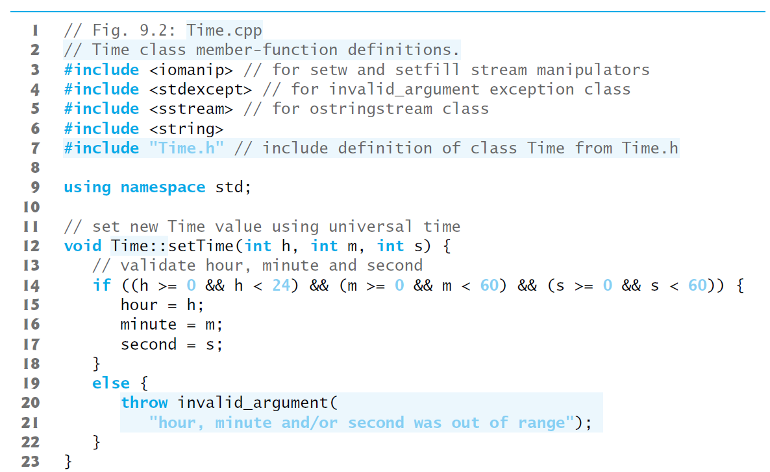
Figure 9.2 Time Class Member-Function Definitions (1 of 2)

Slide 28
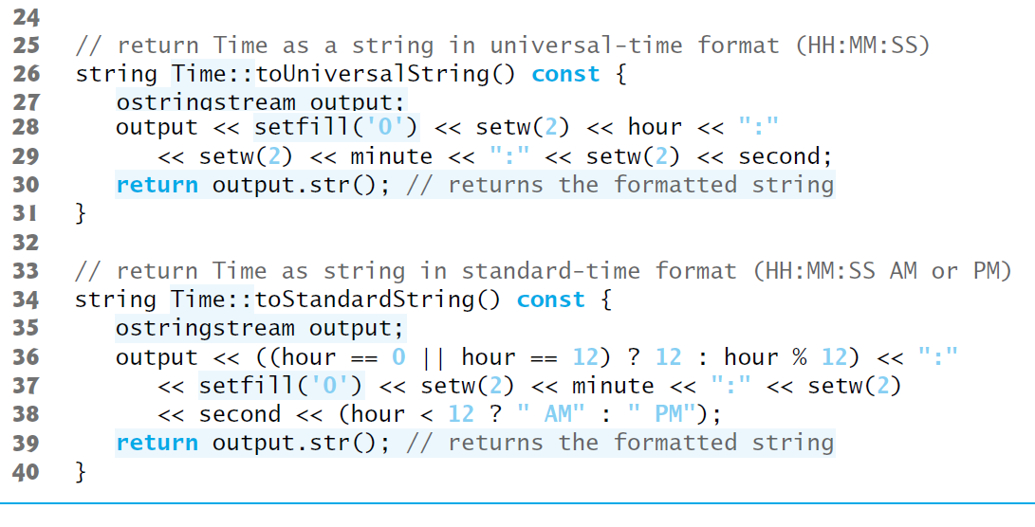
Figure 9.2 Time Class Member-Function Definitions (2 of 2)

Slide 29
9.2.5 Scope Resolution Operator
Each member function’s name (lines 12, 26 and 34) is preceded by the class name and the scope resolution operator (::)
“ties” them to the (now separate) Time class definition (Figure 9.1).
Time:: tells the compiler that each member function is within that class’s scope and its name is known to other class members
Without Time:: preceding each function name, these functions would not be recognized by the compiler as Time member functions
Instead, the compiler would consider them “free” or “loose” functions, like main—these are also called global functions
Such functions cannot access Time’s private data or call the class’s member functions, without specifying an object

Slide 30
Common Programming Error 9.1
When defining a class’s member functions outside that class, omitting the class name and scope resolution operator (::) that should precede the function names causes compilation errors.

Slide 31
9.2.6 Scope Resolution Operator
To indicate that the member functions in Time.cpp are part of class Time, include the Time.h header (Figure 9.2, line 7)
allows us to use the class name Time in the Time.cpp file (lines 12, 26 and 34)
When compiling Time.cpp, the compiler uses Time.h to ensure
the first line of each member function (lines 12, 26 and 34) matches its prototype
each member function knows about the class’s data members and other member functions

Slide 32
9.2.7 Time Class Member Function Settime and Throwing Exceptions
Function setTime tests each argument to determine whether the value is in range
If any of the values is outside its range, setTime throws an invalid_argument exception (from header <stdexcept>)
notifies the client code that an invalid argument was received
Can use try…catch to catch exceptions and attempt to recover from them (Figure 9.3)
The throw statement creates a new object of type invalid_argument, immediately terminates setTime and returns the exception to the code that attempted to set the time

Slide 33
9.2.8 Time Class Member Function toUniversalString and String Stream Processing (1 of 3)
toUniversalString returns a string containing the time formatted as universal time with three colon-separated pairs of digits
1:30:07 P M is returned as "13:30:07".
ostringstream (<sstream>) objects provide the same functionality as c out, but write their output to string
ostringstream’s str member function gets the formatted string

Slide 34
9.2.8 Time Class Member Function toUniversalString and String Stream Processing (2 of 3)
Parameterized stream manipulator setfill specifies the fill character that’s displayed when an integer is output in a field wider than the number of digits in the value
fill characters appear to the left of the digits in the number, because the number is right aligned by default
for left-aligned values (specified with the left stream manipulator) the fill characters would appear to the right
If the minute value is 2, it will be displayed as 02, because the fill character is set to zero ('0')
If the number being output fills the specified field, the fill character will not be displayed

Slide 35
9.2.8 Time Class Member Function toUniversalString and String Stream Processing (3 of 3)
Once the fill character is specified with setfill, it applies for all subsequent values that are displayed in fields wider than the value being displayed
setfill is a sticky setting
This is in contrast to setw, which applies only to the next value displayed
setw is a nonsticky setting
Line 30 calls ostringstream’s str member function to get the formatted string, which is returned to the client.

Slide 36
Error-Prevention Tip 9.2
Each sticky setting (such as a fill character or precision) should be restored to its previous setting when it’s no longer needed. Failure to do so may result in incorrectly formatted output later in a program. Section 13.7.8 discusses how to reset the formatting for an output stream.

Slide 37
9.2.9 Time Class Member Function Tostandardstring
toStandardString returns a string containing the time formatted as standard time with the hour, minute and second values separated by colons and followed by an A M or P M indicator
10:54:27 A M and 1:27:06 P M
Line 36 uses the conditional operator (?:) to determine the value of hour to be displayed—if the hour is 0 or 12 (A M or P M, respectively), it appears as 12; otherwise, we use the remainder operator (%) to have the hour appear as a value from 1 to 11
The conditional operator in line 38 determines whether A M or P M will be displayed.
Line 39 calls ostringstream’s str member function to return the formatted string

Slide 38
9.2.10 Implicitly Inlining Member Functions
If a member function is defined in the class’s body, the compiler attempts to inline calls to the member function.

Slide 39
Performance Tip 9.1
Defining a member function inside the class definition inlines the member function (if the compiler chooses to do so). This can improve performance.

Slide 40
Software Engineering Observation 9.1
Only the simplest and most stable member functions (i.e., whose implementations are unlikely to change) should be defined in the class header, because every change to the header requires you to recompile every source-code file that’s dependent on that header (a time-consuming task in large systems).

Slide 41
9.2.11 Implicitly Inlining Member Functions
toUniversalString and toStandardString take no arguments, because these member functions implicitly know that they’re to create string representations of the data for the particular Time object on which they’re invoked
Can make member-function calls more concise than conventional function calls in procedural programming

Slide 42
Software Engineering Observation 9.2
Using an object-oriented programming approach often requires fewer arguments when calling functions. This benefit derives from the fact that encapsulating data members and member functions within a class gives the member functions the right to access the data members.

Slide 43
Software Engineering Observation 9.3
Member functions are usually shorter than functions in non-object-oriented programs, because the data stored in data members have ideally been validated by a constructor or by member functions that store new data. Because the data is already in the object, the member-function calls often have no arguments or fewer arguments than function calls in non-object-oriented languages. Thus, the calls, the function definitions and the function prototypes are shorter. This improves many aspects of program development.

Slide 44
Error-Prevention Tip 9.3
The fact that member-function calls generally take either no arguments or fewer arguments than conventional function calls in non-object-oriented languages reduces the likelihood of passing the wrong arguments, the wrong types of arguments or the wrong number of arguments.

Slide 45
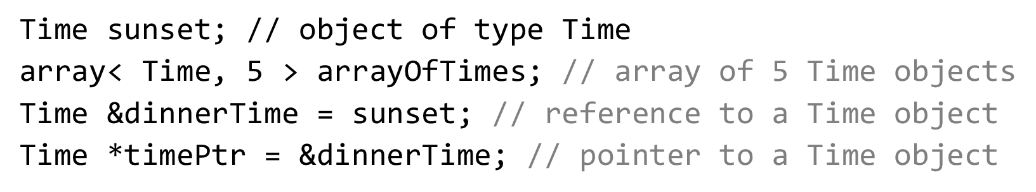
9.2.12 Using Class Time (1 of 2)
Time can be used as a type in object, array, pointer and reference declarations as follows:
Figure 9.3 uses class Time
Separating Time’s interface from the implementation of its member functions does not affect the way that this client code uses the class

Slide 46
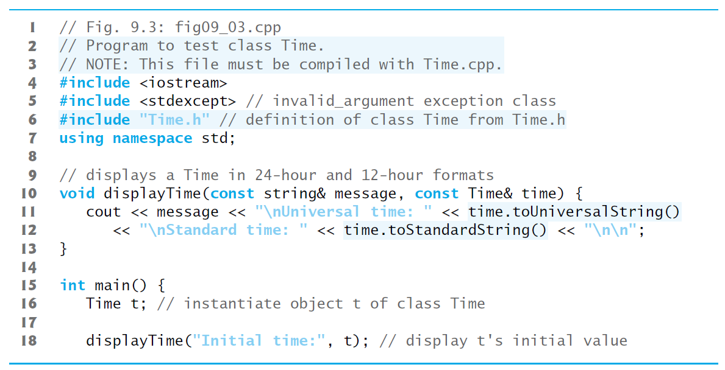
Figure 9.3 Program to Test Class Time (1 of 3)

Slide 47
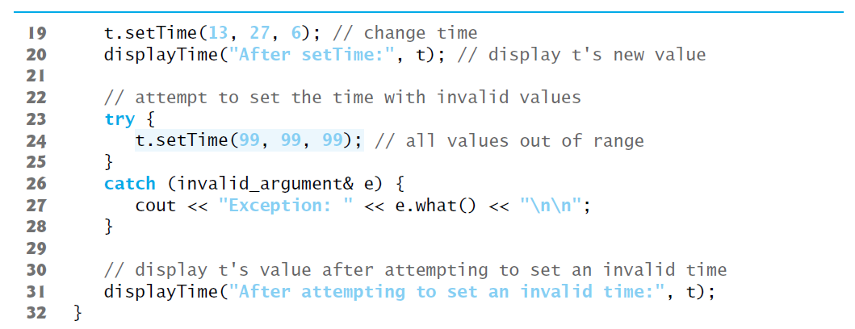
Figure 9.3 Program to Test Class Time (2 of 3)

Slide 48
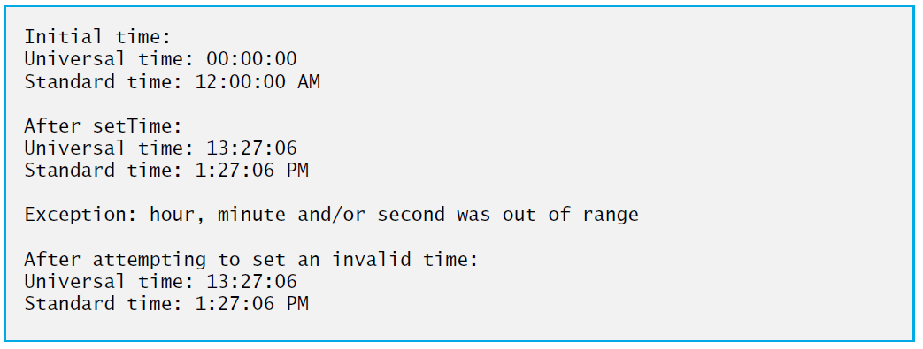
Figure 9.3 Program to Test Class Time (3 of 3)

Slide 49
9.2.12 Using Class Time (2 of 2)
Line 16 creates the Time object t
Recall that class Time does not define a constructor, so line 16 invokes the compiler-generated default constructor, and t’s hour, minute and second are set to 0 via their initializers in class Time’s definition
To illustrate that the setTime member function validates its arguments, line 24 calls setTime with invalid arguments
This statement is placed in a try block
When an exception occurs, it’ s caught at lines 26–28, and line 27 displays the exception’s error message by calling its what member function
Line 31 displays the time again to confirm that setTime did not change the time when invalid arguments were supplied

Slide 50
9.2.13 Object Size
People new to object-oriented programming often suppose that objects must be quite large because they contain data members and member functions.
Logically, this is true—you may think of objects as containing data and functions (and our discussion has certainly encouraged this view); physically, however, this is not true.

Slide 51
Performance Tip 9.2
Objects contain only data, so objects are much smaller than if they also contained member functions. The compiler creates one copy (only) of the member functions separate from all objects of the class. All objects of the class share this one copy. Each object, of course, needs its own copy of the class’s data, because the data can vary among the objects. The function code is the same for all objects of the class and, hence, can be shared among them.

Slide 52
9.3 Compilation and Linking Process (1 of 5)
The diagram in Figure 9.4 shows the compilation and linking process that results in an executable Time application
Often a class’s interface and implementation will be created and compiled by one programmer and used by a separate programmer who implements the client code that uses the class
Diagram shows what’s required by both the class-implementation programmer and the client-code programmer
Dashed lines show the pieces required by the class-implementation programmer, the client-code programmer and the Time application user, respectively

Slide 53
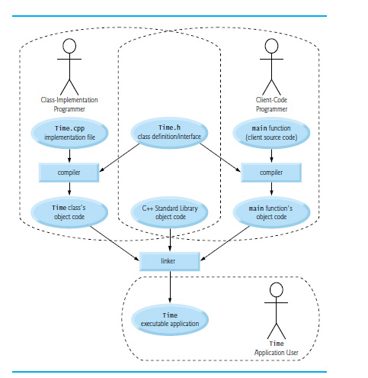
Figure 9.4 Compilation and Linking Process That Produces an Executable Application

Slide 54
9.3 Compilation and Linking Process (2 of 5)
A class-implementation programmer responsible for creating a reusable Time class creates the header Time.h and the source-code file Time.cpp that #includes the header, then compiles the source-code file to create Time’s object code
To hide the class’s member-function implementation details, the class-implementation programmer would provide the client-code programmer with the header Time.h (which specifies the class’s interface and data members) and the Time object code (i.e., the machine-code instructions that represent Time’s member functions).

Slide 55
9.3 Compilation and Linking Process (3 of 5)
The client-code programmer is not given Time.cpp, so the client remains unaware of how Time’s member functions are implemented
The client-code programmer needs to know only Time’s interface to use the class and must be able to link its object code
Since the interface of the class is part of the class definition in the Time.h header, the client-code programmer must have access to this file and must #include it in the client’s source-code file
When the client code is compiled, the compiler uses the class definition in Time.h to ensure that the main function creates and manipulates objects of class Time correctly

Slide 56
9.3 Compilation and Linking Process (4 of 5)
To create the executable Time application, the last step is to link
the object code for the main function (i.e., the client code),
the object code for class Time’s member-function implementations, and
the C++ Standard Library object code for the C++ classes (e.g., string) used by the class-implementation programmer and the client-code programmer.
The linker’s output is the executable Time application that users can execute to create and manipulate a Time object
Compilers and I D E s typically invoke the linker for you after compiling your code

Slide 57
9.3 Compilation and Linking Process (5 of 5)
Compiling Programs Containing Two or More Source-Code Files
In Microsoft Visual Studio, add to your project all the headers and source-code files that make up a program, then build and run the project
For G N U C++, open a shell and change to the directory containing all the files for a given program, then execute the following command:
*.cpp specifies to compile and link all of the source-code files in the current directory—the preprocessor automatically locates the headers in that directory.
For Apple Xcode, add to your project all the headers and source-code files that make up a program, then build and run the project

Slide 58
9.4 Class Scope and Accessing Class Members (1 of 4)
A class’s data members and member functions belong to that class’s scope.
Nonmember functions are defined at global namespace scope, by default.
Within a class’s scope, class members are immediately accessible by all of that class’s member functions and can be referenced by name.
Outside a class’s scope, public class members are referenced through one of the handles on an object—an object name, a reference to an object or a pointer to an object.

Slide 59
9.4 Class Scope and Accessing Class Members (2 of 4)
Dot (.) and Arrow (->) Member Selection Operators
As you know, you can use an object’s name—or a reference to an object—followed by the dot member-selection operator (.) to access an object’s members
To reference an object’s members via a pointer to an object, follow the pointer name by the arrow member-selection operator (->) and the member name, as in pointerName->memberName.

Slide 60
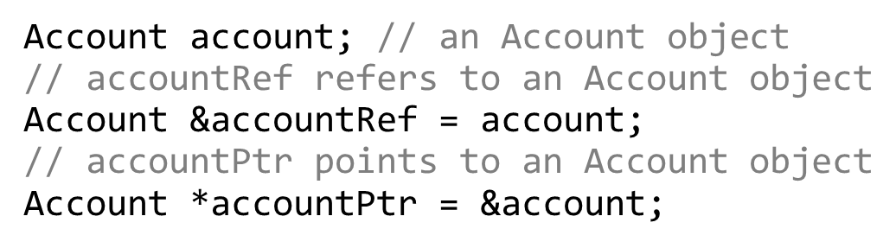
9.4 Class Scope and Accessing Class Members (3 of 4)
Accessing public Class Members Through Objects, References and Pointers
Consider an Account class that has a public setBalance member function. Given the following declarations:

Slide 61
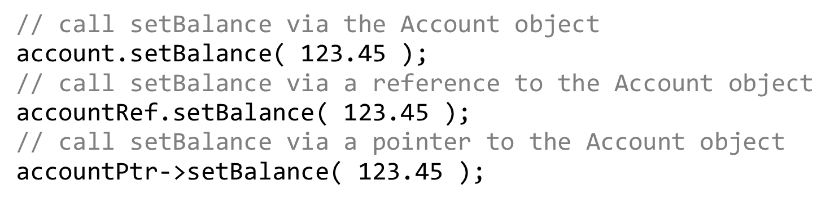
9.4 Class Scope and Accessing Class Members (4 of 4)
You can invoke member function setBalance using the dot (.) and arrow (->) member selection operators as follows:

Slide 62
9.5 Access Functions and Utility Functions
Access Functions
Access functions can read or display data.
A common use for access functions is to test the truth or falsity of conditions—such functions are often called predicate functions.
Utility Functions
A utility function (also called a helper function) is a private member function that supports the operation of the class’s other member functions.

Slide 63
9.6 Time Class Case Study: Constructors with Default Arguments (1 of 2)
The program of Figures 9.4–9.6 enhances class Time to demonstrate how arguments are implicitly passed to a constructor.

Slide 64
9.6.1 Constructors with Default Arguments
Like other functions, constructors can specify default arguments.
Line 13 of Figure 9.5 declares a Time constructor with default arguments, specifying a default value of zero for each argument passed to the constructor
The constructor is declared explicit because it can be called with one argument
We discuss explicit constructors in detail in Section 10.13

Slide 65
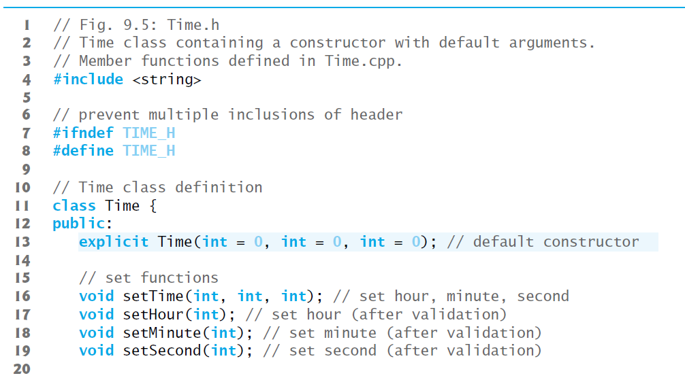
Figure 9.5 Time Class Containing a Constructor with Default Arguments (1 of 2)

Slide 66
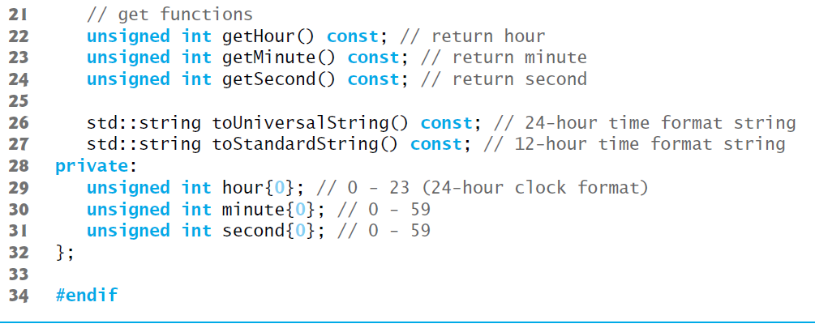
Figure 9.5 Time Class Containing a Constructor with Default Arguments (2 of 2)

Slide 67
Software Engineering Observation 9.4
Any change to the default argument values of a function requires the client code to be recompiled (to ensure that the program still functions correctly).

Slide 68
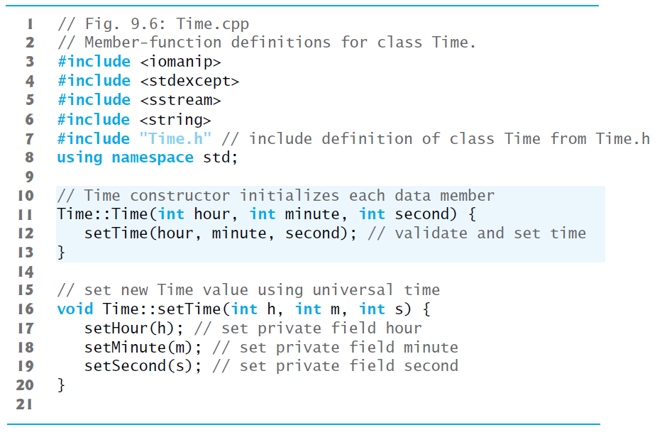
Figure 9.6 Member-Function Definitions for Class Time (1 of 4)

Slide 69
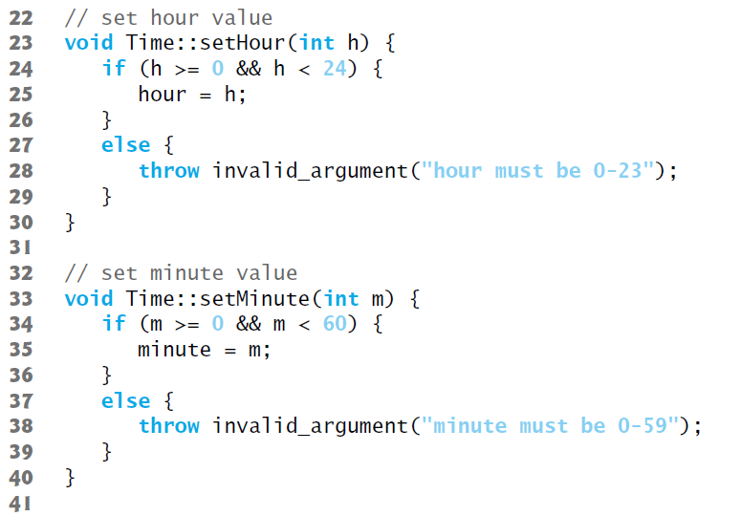
Figure 9.6 Member-Function Definitions for Class Time (2 of 4)

Slide 70
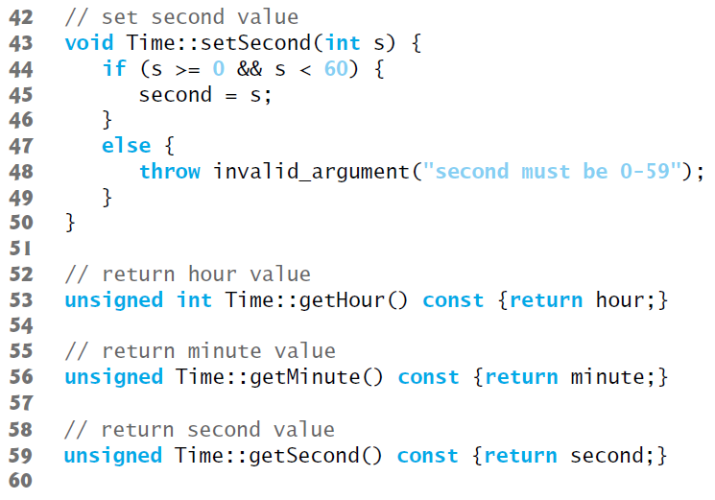
Figure 9.6 Member-Function Definitions for Class Time (3 of 4)

Slide 71
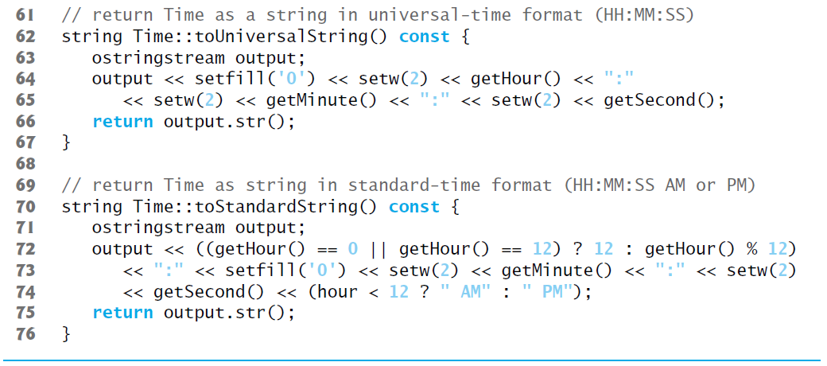
Figure 9.6 Member-Function Definitions for Class Time (4 of 4)

Slide 72
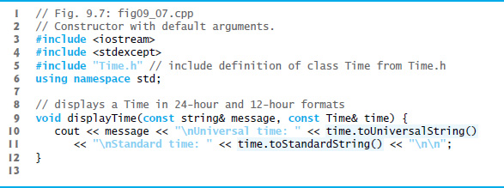
Figure 9.7 Constructor with Default Arguments (1 of 3)

Slide 73
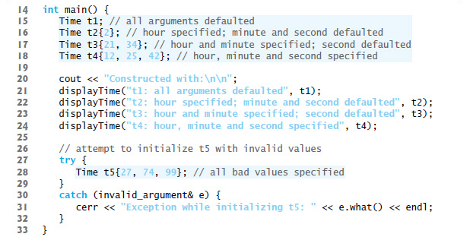
Figure 9.7 Constructor with Default Arguments (2 of 3)

Slide 74
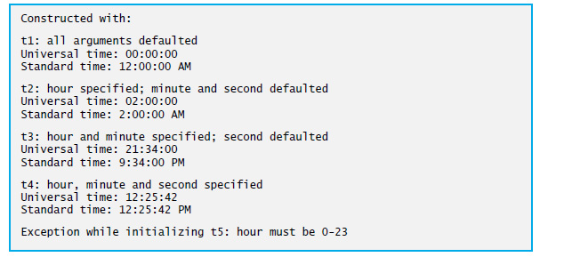
Figure 9.7 Constructor with Default Arguments (3 of 3)

Slide 75
9.6 Time Class Case Study: Constructors with Default Arguments (2 of 2)
Notes Regarding Time’s Set and Get Functions and Constructor
Time’s set and get functions are called throughout the class’s body.
In each case, these functions could have accessed the class’s private data directly.
Consider changing the representation of the time from three int values (requiring 12 bytes of memory on systems with four-byte ints) to a single int value representing the total number of seconds that have elapsed since midnight (requiring only four bytes of memory).
If we made such a change, only the bodies of the functions that access the private data directly would need to change.
No need to modify the bodies of the other functions.

Slide 76
Software Engineering Observation 9.5
If a member function of a class already provides all or part of the functionality required by a constructor or other member functions of the class, call that member function from the constructor or other member functions. This simplifies the maintenance of the code and reduces the likelihood of an error if the code implementation is modified. As a general rule: Avoid repeating code.

Slide 77
Common Programming Error 9.2
A constructor can call other member functions of the class, such as set or get functions, but because the constructor is initializing the object, the data members may not yet be initialized Using data members before they have been properly initialized can cause logic errors.

Slide 78
Software Engineering Observation 9.6
Making data members private and controlling access, especially write access, to those data members through public member functions helps ensure data integrity.

Slide 79
Error-Prevention Tip 9.4
The benefits of data integrity are not automatic simply because data members are made private—you must provide appropriate validity checking.

Slide 80
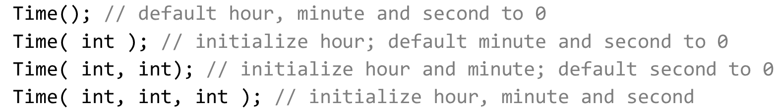
9.6.2 Overloaded Constructors and C++11 Delegating Constructors
In Figures 9.5–9.7, the Time constructor with three parameters had a default argument for each parameter. We could have defined that constructor instead as four overloaded constructors with the following prototypes:
C++11 allows constructors to call other constructors in the same class.
The calling constructor is known as a delegating constructor—it delegates its work to another constructor

Slide 81
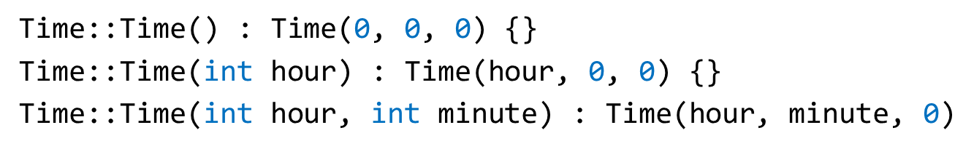
9.6.2 Overloaded Constructors and C++11 Delegating Constructors
The first three of the four Time constructors can delegate work to one with three int arguments, passing 0 as the default value for the extra parameters.
Use a member initializer with the name of the class as follows:

Slide 82
9.7 Destructors
The name of the destructor is the tilde character (~) followed by the class name.
Called implicitly when an object is destroyed.
The destructor itself does not actually release the object’s memory
it performs termination housekeeping before the object’s memory is reclaimed, so the memory may be reused to hold new objects
Receives no parameters and returns no value.
May not specify a return type—not even void.
A class has one destructor.
A destructor must be public.
If you do not explicitly define a destructor, the compiler defines an “empty” destructor.

Slide 83
9.8 When Constructors and Destructors Are Called
Constructors and destructors are called implicitly.
The order in which these function calls occur depends on the order in which execution enters and leaves the scopes where the objects are instantiated.
Generally, destructor calls are made in the reverse order of the corresponding constructor calls
Global and static objects can alter the order in which destructors are called.

Slide 84
9.8.1 Constructors and Destructors for Objects in Global Scope
Constructors are called for objects defined in global scope (also called global namespace scope) before any other function (including main) in that program begins execution (although the order of execution of global object constructors between files is not guaranteed).
The corresponding destructors are called when main terminates.
Function exit forces a program to terminate immediately and does not execute the destructors of local objects.
Function abort performs similarly to function exit but forces the program to terminate immediately, without allowing programmer-defined cleanup code to be called.

Slide 85
9.8.2 Constructors and Destructors for Non-Static Local Objects
Constructors and destructors for non-static local objects are called each time execution enters and leaves the scope of the object.
Destructors are not called for non-static local objects if the program terminates with a call to function exit or function abort.

Slide 86
9.8.3 Constructors and Destructors for Static Local Objects
The constructor for a static local object is called only once, when execution first reaches the point where the object is defined—the corresponding destructor is called when main terminates or the program calls function exit.
Global and static objects are destroyed in the reverse order of their creation.
Destructors are not called for static objects if the program terminates with a call to function abort.

Slide 87
9.8.4 Demonstrating When Constructors and Destructors Are Called
The program of Figures 9.8–9.10 demonstrates the order in which constructors and destructors are called for objects of class CreateAndDestroy (Figure 9.8 and Figure 9.9) of various global, local and local static objects.

Slide 88
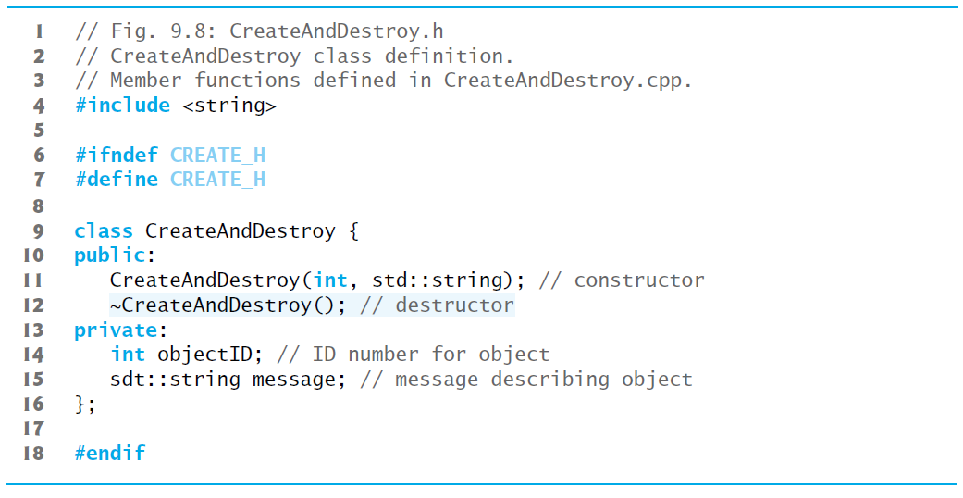
Figure 9.8 CreateAndDestroy Class Definition

Slide 89
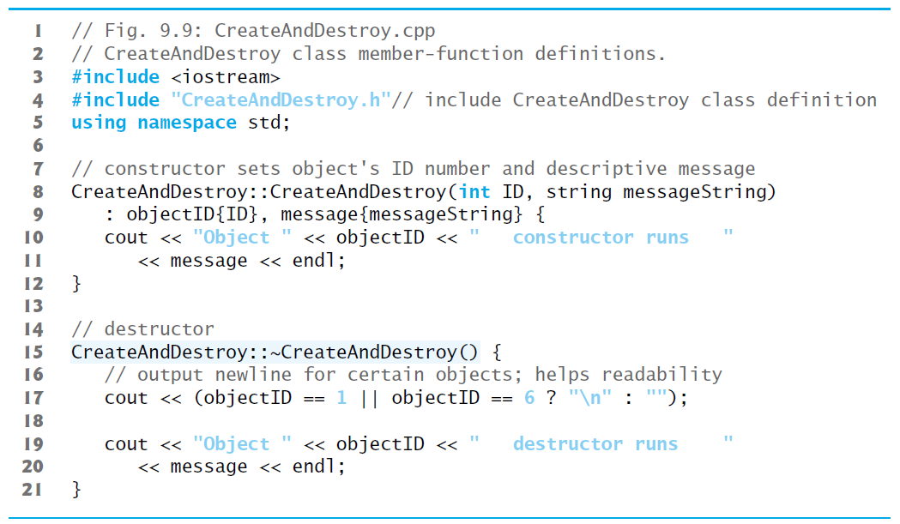
Figure 9.9 CreateAndDestroy Class Member-Function Definitions

Slide 90
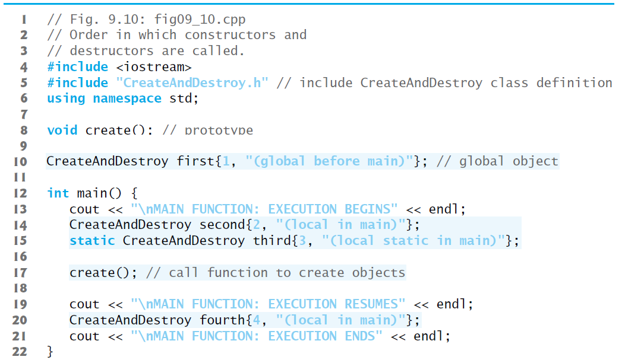
Figure 9.10 Order in Which Constructors and Destructors Are Called (1 of 3)

Slide 91
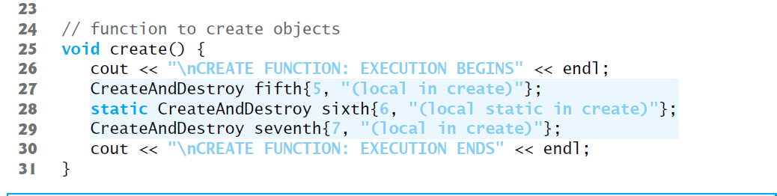
Figure 9.10 Order in Which Constructors and Destructors Are Called (2 of 3)

Slide 92
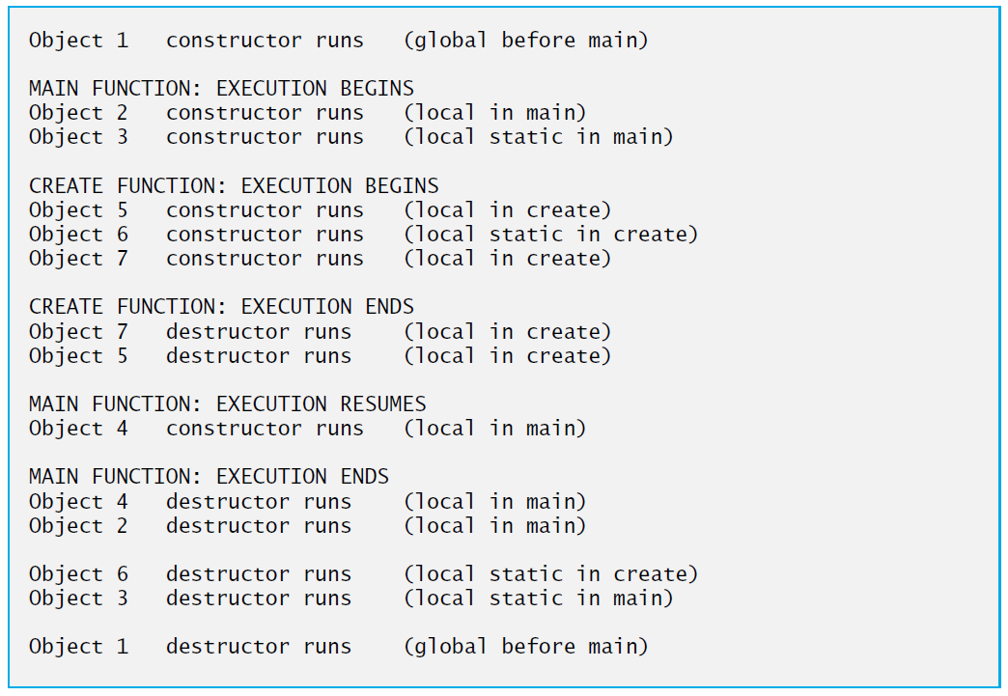
Figure 9.10 Order in Which Constructors and Destructors Are Called (3 of 3)

Slide 93
9.9 Time Class Case Study: A Subtle Trap—Returning a Reference or a Pointer to a Private Data Member
A reference to an object is an alias for the object’s name
May be used on the left side of an assignment statement
Acceptable lvalue that can receive a value
A member function can return a reference to a private data member
If the reference return type is declared const, the reference is a nonmodifiable lvalue and cannot be used to modify the data.
If the reference return type is not declared const, subtle errors can occur.
A reference return actually makes a call to member function badSetHour an alias for private data member hour!
The function call can be used in any way that the private data member can be used

Slide 94
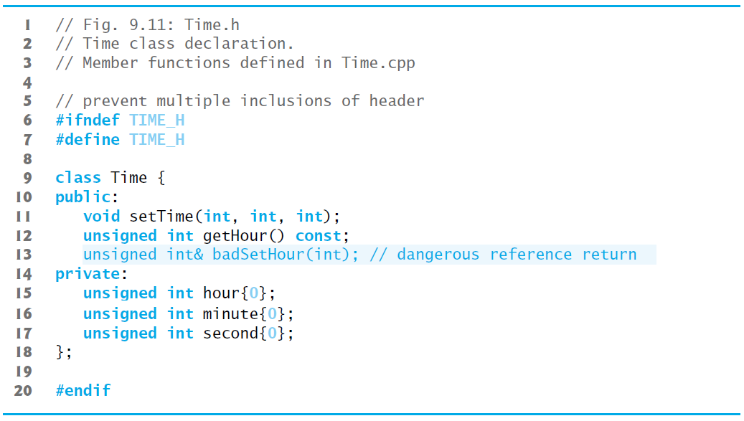
Figure 9.11 Time Class Declaration

Slide 95
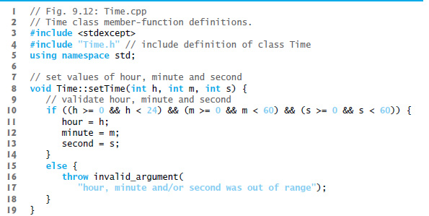
Figure 9.12 Time Class Member-Function Definitions (1 of 2)

Slide 96
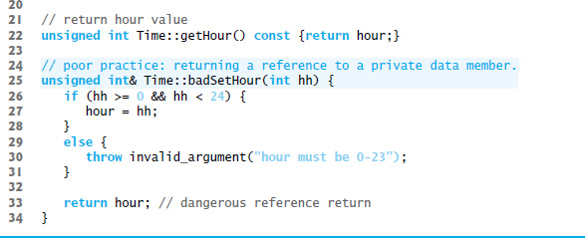
Figure 9.12 Time Class Member-Function Definitions (2 of 2)

Slide 97
Software Engineering Observation 9.7
Returning a reference or a pointer to a private data member breaks the encapsulation of the class and makes the client code dependent on the representation of the class’s data.There are cases where doing this is appropriate—we’ll show an example of this when we build our custom Array class in Section 10.10.

Slide 98
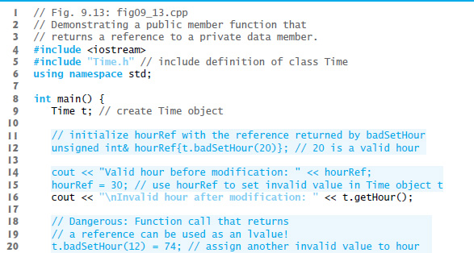
Figure 9.13 Public Member Function That Returns a Reference to a Private Data Member (1 of 2)

Slide 99
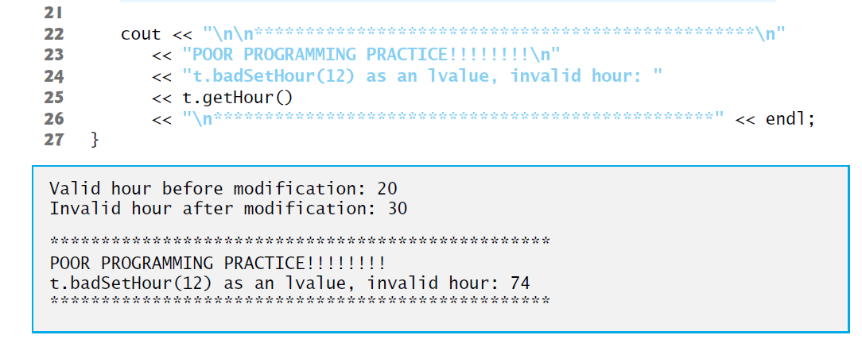
Figure 9.13 Public Member Function That Returns a Reference to a Private Data Member (2 of 2)

Slide 100
9.10 Default Memberwise Assignment (1 of 2)
The assignment operator (=) can be used to assign an object to another object of the same type.
By default, such assignment is performed by memberwise assignment (also called copy assignment).
Each data member of the object on the right of the assignment operator is assigned individually to the same data member in the object on the left of the assignment operator.
[Caution: Memberwise assignment can cause serious problems when used with a class whose data members contain pointers to dynamically allocated memory; we discuss these problems in Chapter 10 and show how to deal with them.]

Slide 101
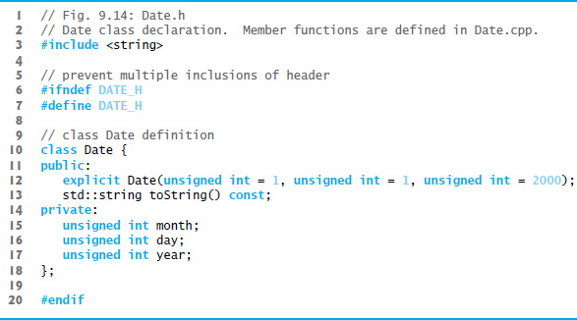
Figure 9.14 Date Class Declaration

Slide 102
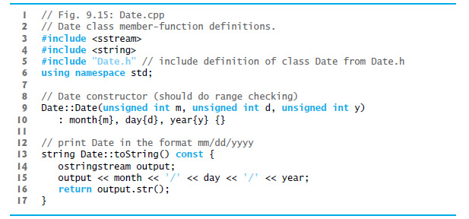
Figure 9.15 Date Class Member-Function Definitions

Slide 103
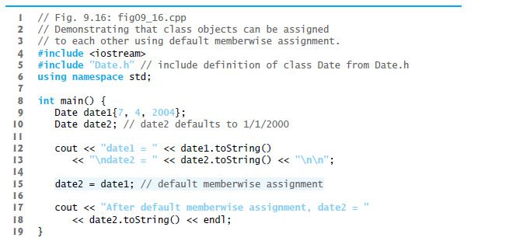
Figure 9.16 Class Objects Can Be Assigned to Each Other Using Default Memberwise Assignment (1 of 2)

Slide 104
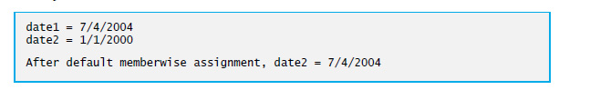
Figure 9.16 Class Objects Can Be Assigned to Each Other Using Default Memberwise Assignment (2 of 2)

Slide 105
9.10 Default Memberwise Assignment (2 of 2)
Objects may be passed as function arguments and may be returned from functions.
Such passing and returning is performed using pass-by-value by default—a copy of the object is passed or returned.
C++ creates a new object and uses a copy constructor to copy the original object’s values into the new object.
For each class, the compiler provides a default copy constructor that copies each member of the original object into the corresponding member of the new object.
Copy constructors can cause serious problems when used with a class whose data members contain pointers to dynamically allocated memory.
Chapter 10 discusses customized copy constructors.

Slide 106
9.11 Const Objects and Const Member Functions (1 of 3)
Some objects need to be modifiable and some do not.
You may use keyword const to specify that an object is not modifiable and that any attempt to modify the object should result in a compilation error.
The statement
const Time noon( 12, 0, 0 );
declares a const object noon of class Time and initializes it to 12 noon. It’s possible to instantiate const and non- const objects of the same class.

Slide 107
Error-Prevention Tip 9.5
Attempts to modify a const object are caught at compile time rather than causing execution-time errors.

Slide 108
Performance Tip 9.3
Declaring variables and objects const when appropriate can improve performance—compilers can perform optimizations on constants that cannot be performed on non-const variables.

Slide 109
9.10 Const Objects and Const Member Functions
C++ disallows member function calls for const objects unless the member functions themselves are also declared const.
This is true even for get member functions that do not modify the object.
This is also a key reason that we’ve declared as const all member-functions that do not modify the objects on which they’re called.

Slide 110
Common Programming Error 9.3
Defining as const a member function that calls a non-const member function of the class on the same object is a compilation error.

Slide 111
Common Programming Error 9.4
Invoking a non-const member function on a const object is a compilation error.

Slide 112
9.11 Const Objects and Const Member Functions (2 of 3)
A constructor must be allowed to modify an object so that the object can be initialized properly.
A destructor must be able to perform its termination housekeeping chores before an object’s memory is reclaimed by the system.
Attempting to declare a constructor or destructor const is a compilation error.
The “constness” of a const object is enforced from the time the constructor completes initialization of the object until that object’s destructor is called.

Slide 113
9.11 Const Objects and Const Member Functions (3 of 3)
Using const and Non-const Member Functions
The program of Figure 9.16 uses class Time from Figures 9.4–9.5, but removes const from function toStandardString’s prototype and definition so that we can show a compilation error.

Slide 114
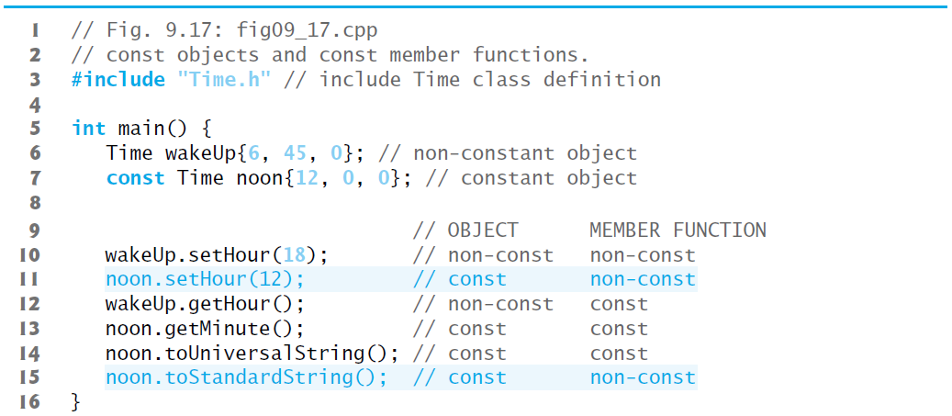
Figure 9.17 Const Objects and Const Member Functions (1 of 2)

Slide 115
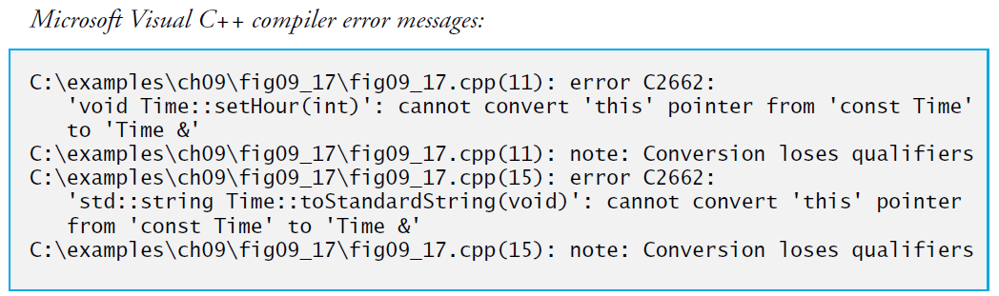
Figure 9.17 Const Objects and Const Member Functions (2 of 2)

Slide 116
9.12 Composition: Objects as Members of Classes (1 of 5)
An AlarmClock object needs to know when it’s supposed to sound its alarm, so why not include a Time object as a member of the AlarmClock class?
Such a capability is called composition (or aggregation) and is sometimes referred to as a has-a relationship—a class can have objects of other classes as members.
The next program uses classes Date (Figures 9.18–9.19) and Employee (Figures 9.20–9.21) to demonstrate composition.

Slide 117
Software Engineering Observation 9.8
Data members are constructed in the order in which they’re declared in the class definition (not in the order they’re listed in the constructor’s member-initializer list) and before their enclosing class objects are constructed.

Slide 118
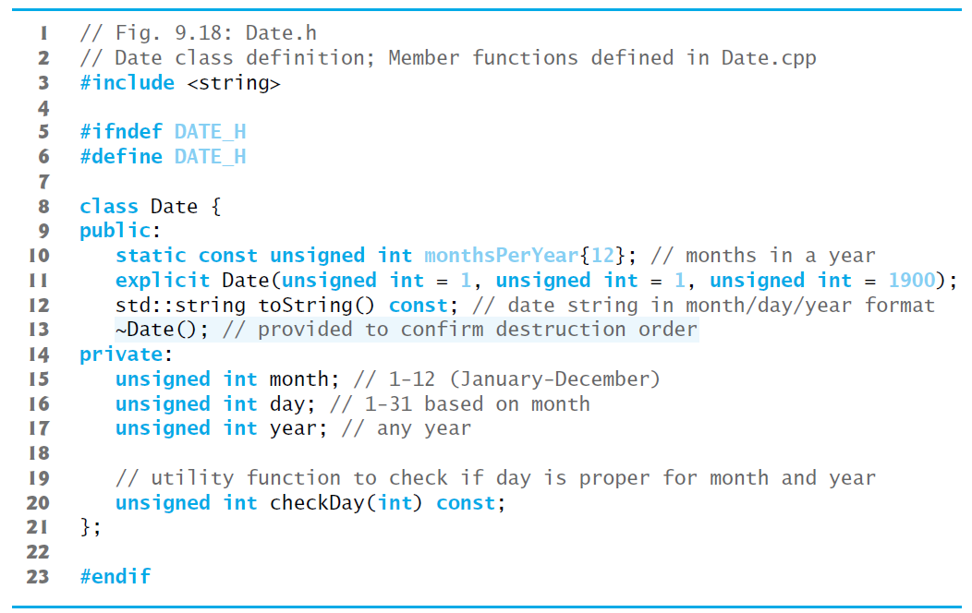
Figure 9.18 Date Class Definition

Slide 119
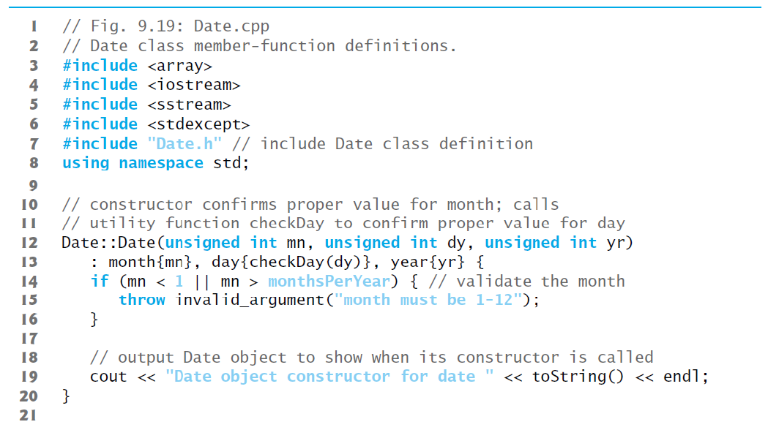
Figure 9.19 Date Class Member-Function definitions (1 of 3)

Slide 120
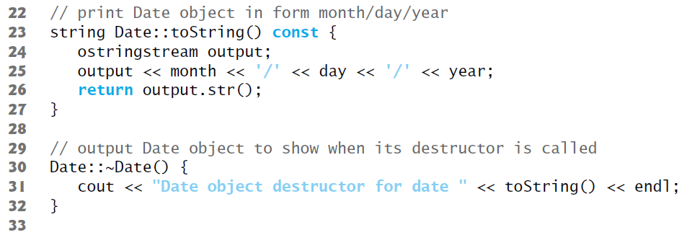
Figure 9.19 Date Class Member-Function definitions (2 of 3)

Slide 121
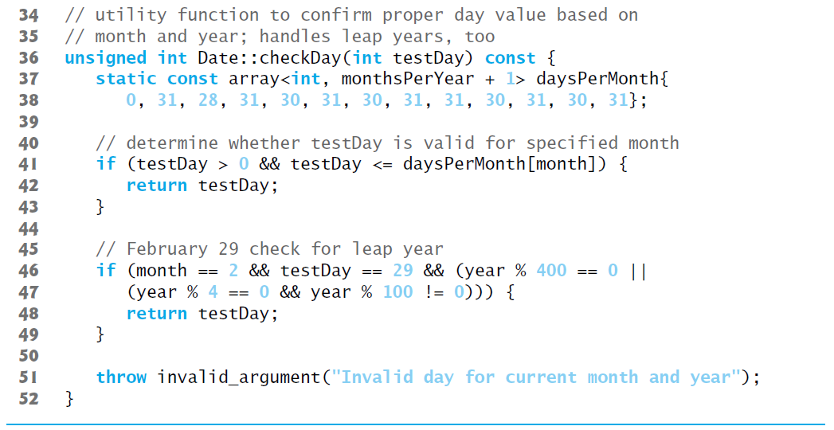
Figure 9.19 Date Class Member-Function definitions (3 of 3)

Slide 122
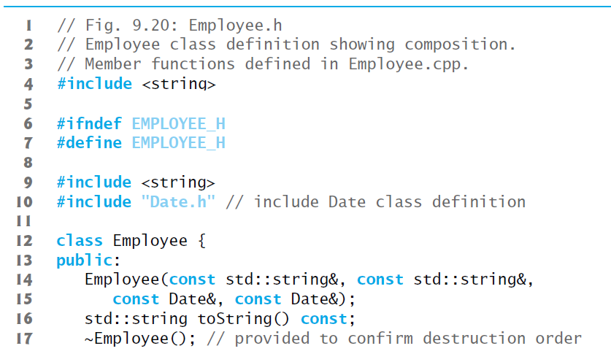
Figure 9.20 Employee Class Definition Showing Composition (1 of 2)

Slide 123
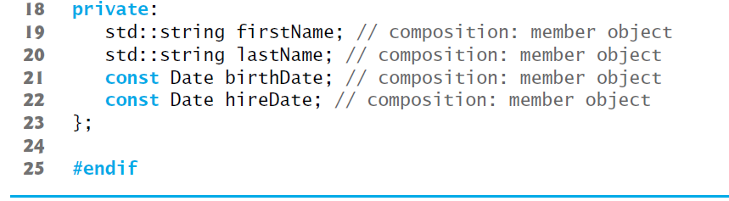
Figure 9.20 Employee Class Definition Showing Composition (2 of 2)

Slide 124
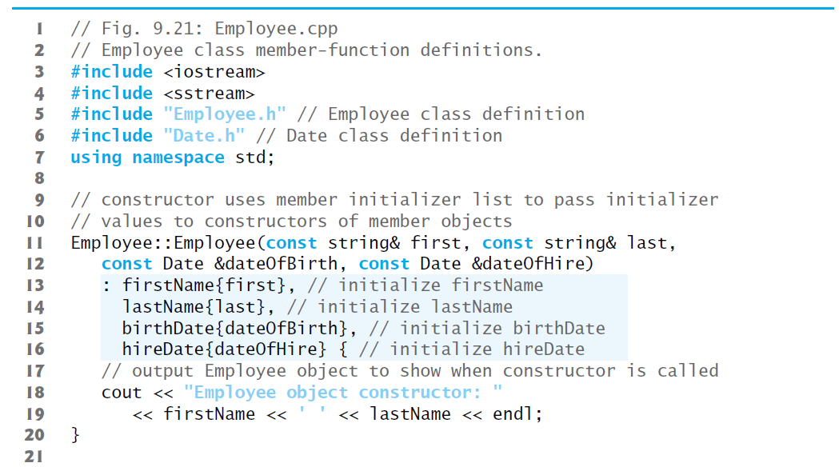
Figure 9.21 Employee Class Member-Function Definitions (1 of 2)

Slide 125
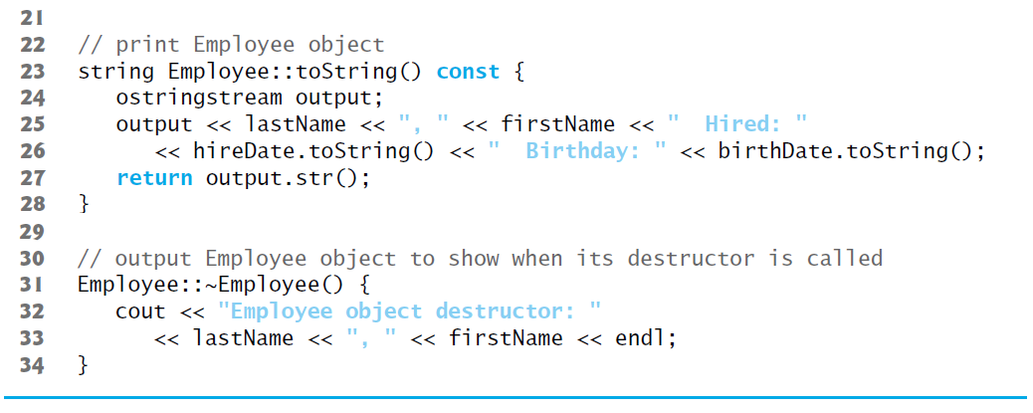
Figure 9.21 Employee Class Member-Function Definitions (2 of 2)

Slide 126
9.12 Composition: Objects as Members of Classes (2 of 5)
Employee Constructor’s Member Initializer List
The colon (:) following the constructor’s header (Figure 9.20, line 12) begins the member initializer list.
The member initializers specify the Employee constructor parameters being passed to the constructors of the string and Date data members.
Again, member initializers are separated by commas.
The order of the member initializers does not matter.
They’re executed in the order that the member objects are declared in class Employee.

Slide 127
Good Programming Practice 9.2
For clarity, list the member initializers in the order that the class’s data members are declared.

Slide 128
9.12 Composition: Objects as Members of Classes (3 of 5)
Date Class’s Default Copy Constructor
As we mentioned in Section 9.9, the compiler provides each class with a default copy constructor that copies each data member of the constructor’s argument object into the corresponding member of the object being initialized.
Chapter 10 discusses how you can define customized copy constructors.

Slide 129
9.12 Composition: Objects as Members of Classes (4 of 5)
Testing Classes Date and Employee
Figure 9.22 creates two Date objects (lines 9–10) and passes them as arguments to the constructor of the Employee object created in line 11
There are actually five constructor calls when an Employee is constructed:
two calls to the string class’s constructor (lines 13–14 of Figure 9.21),
two calls to the Date class’s default copy constructor (lines 15–16 of Figure 9.21),
and the call to the Employee class’s constructor.
When each Date object is created, the Date constructor displays a line of output to show that the constructor was called (see the first two lines of the sample output).

Slide 130
9.12 Composition: Objects as Members of Classes (5 of 5)
[Note: Line 11 of Figure 9.22 causes two additional Date constructor calls that do not appear in the program’s output. When each of the Employee’s Date member objects is initialized in the Employee constructor’s member-initializer list, the default copy constructor for class Date is called. Since this constructor is defined implicitly by the compiler, it does not contain any output statements to demonstrate when it’s called.]

Slide 131
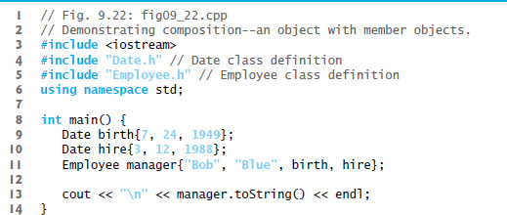
Figure 9.22 Demonstrating Composition—an Object with Member Objects (1 of 2)

Slide 132
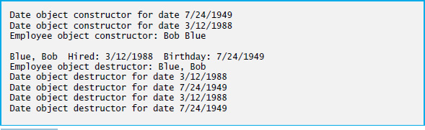
Figure 9.22 Demonstrating Composition—an Object with Member Objects (2 of 2)

Slide 133
9.11 Composition: Objects as Members of Classes
What Happens When You Do Not Use the Member Initializer List?
If a member object is not initialized through a member initializer, the member object’s default constructor will be called implicitly.
Values, if any, established by the default constructor can be overridden by set functions.
However, for complex initialization, this approach may require significant additional work and time.

Slide 134
Performance Tip 9.4
Initialize member objects explicitly through member initializers. This eliminates the overhead of “doubly initializing” member objects—once when the member object’s default constructor is called and again when set functions are called in the constructor body (or later) to initialize the member object.

Slide 135
Common Programming Error 9.5
A compilation error occurs if a member object is not initialized with a member initializer and the member object’s class does not provide a default constructor (i.e., the member object’s class defines one or more constructors, but none is a default constructor).

Slide 136
Software Engineering Observation 9.9
If a data member is an object of another class, making that member object public does not violate the encapsulation and hiding of that member object’s private members. But, it does violate the encapsulation and hiding of the enclosing class’s implementation, somember objects of class types should still be private.

Slide 137
9.13 Friend Functions and Friend Classes (1 of 5)
A friend function of a class is a non-member function that has the right to access the public and non-public class members.
Standalone functions, entire classes or member functions of other classes may be declared to be friends of another class.

Slide 138

9.13 Friend Functions and Friend Classes (2 of 5)
Declaring a friend
To declare a non-member function as a friend of a class, place the function prototype in the class definition and precede it with keyword friend.
To declare all member functions of class ClassTwo as friends of class ClassOne, place a declaration of the form
in the definition of class ClassOne.
The friend declaration(s) can appear anywhere in a class and are not affected by access specifiers public or private (or protected, which we discuss in Chapter 11).

Slide 139
9.13 Friend Functions and Friend Classes (3 of 5)
Friendship is granted, not taken—for class B to be a friend of class A, class A must explicitly declare that class B is its friend.
Friendship is not symmetric—if class A is a friend of class B, you cannot infer that class B is a friend of class A.
Friendship is not transitive—if class A is a friend of class B and class B is a friend of class C, you cannot infer that class A is a friend of class C.

Slide 140
9.13 Friend Functions and Friend Classes (4 of 5)
Modifying a Class’s private Data with a Friend Function
Figure 9.23 defines friend function setX to set the private data member x of class Count.
Function setX is a stand-alone (global) function—it isn’t a member function of class Count.
When setX is invoked for object counter, line 41 passes counter as an argument to setX rather than using a handle (such as the name of the object) to call the function, as in
If you remove the friend declaration in line 8, you’ll receive error messages indicating that function setX cannot modify class Count’s private data member x.

Slide 141
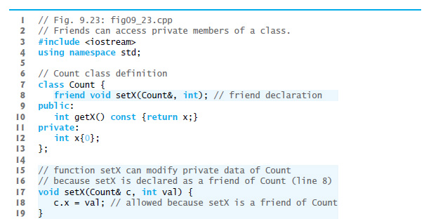
Figure 9.23 Friends Can access Private Members of a Class (1 of 2)

Slide 142
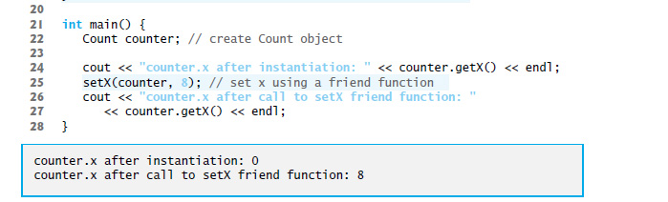
Figure 9.23 Friends Can access Private Members of a Class (2 of 2)

Slide 143
9.13 Friend Functions and Friend Classes (5 of 5)
Overloaded friend Functions
It’s possible to specify overloaded functions as friends of a class.
Each function intended to be a friend must be explicitly declared in the class definition as a friend of the class.

Slide 144
Software Engineering Observation 9.10
Even though the prototypes for friend functions appear in the class definition, friends are not member functions.

Slide 145
Software Engineering Observation 9.11
Member access notions of private, protected and public are not relevant to friend declarations, so friend declarations can be placed anywhere in a class definition.

Slide 146
Good Programming Practice 9.3
Place all friendship declarations first inside the class definition’s body and do not precede them with any access specifier.

Slide 147
9.14 Using the This Pointer (1 of 4)
Every object has access to its own address through a pointer called this (a C++ keyword).
The this pointer is not part of the object itself—i.e., the memory occupied by the this pointer is not reflected in the result of a sizeof operation on the object.
Rather, the this pointer is passed (by the compiler) as an implicit argument to each of the object’s non-static member functions.

Slide 148
9.14 Using the This Pointer (2 of 4)
Using the this Pointer to Avoid Naming Collisions
Member functions use the this pointer implicitly (as we’ve done so far) or explicitly to reference an object’s data members and other member functions.
A common explicit use of the this pointer is to avoid naming conflicts between a class’s data members and member-function parameters (or other local variables).

Slide 149
9.14 Using the This Pointer (3 of 4)
Member functions use the this pointer implicitly or explicitly to reference an object’s data members and other member functions
A common explicit use of the this pointer is to avoid naming conflicts between a class’s data members and member-function parameters (or other local variables)

Slide 150
Good Programming Practice 9.4
A widely accepted practice to minimize the proliferation of identifier names is to use the same name for a set function’s parameter and the data member it sets, and to reference the data member in the set function’s body via this->.

Slide 151
9.14 Using the This Pointer (4 of 4)
Type of the this Pointer
The type of the this pointer depends on the type of the object and whether the member function in which this is used is declared const
In a non-const member function of class Employee, the this pointer has the type Employee* const—a constant pointer to a nonconstant Employee.
In a const member function, this has the type const Employee* const—a constant pointer to a constant Employee.

Slide 152
9.14.1 Implicitly and Explicitly Using the This Pointer to Access An Object’s Data Members
Figure 9.24 demonstrates the implicit and explicit use of the this pointer to enable a member function of class Test to print the private data x of a Test object.

Slide 153

Figure 9.24 Using the this pointer to refer to object members (1 of 2)

Slide 154

Figure 9.24 Using the this pointer to refer to object members (2 of 2)

Slide 155
9.14.2 Using the This Pointer to Enable Cascaded Function Calls
Another use of the this pointer is to enable cascaded member-function calls—that is, invoking multiple functions sequentially in the same statement
The program of Figures 9.25–9.27 modifies class Time’s set functions setTime, setHour, setMinute and setSecond such that each returns a reference to a Time object to enable cascaded member-function calls.
The last statement in the body of each of these member functions returns * into a return type of Time &.
The program of Figure 9.27 creates Time object t, then uses it in cascaded member-function calls

Slide 156

Figure 9.25 Time Class Modified to Enable Cascaded Member-Function Calls (1 of 2)

Slide 157

Figure 9.25 Time Class Modified to Enable Cascaded Member-Function Calls (2 of 2)

Slide 158

Figure 9.26 Time Class Member-Function Definitions Modified to Enable Cascaded Member-Function Calls (1 of 4)

Slide 159

Figure 9.26 Time Class Member-Function Definitions Modified to Enable Cascaded Member-Function Calls (2 of 4)

Slide 160

Figure 9.26 Time Class Member-Function Definitions Modified to Enable Cascaded Member-Function Calls (3 of 4)

Slide 161

Figure 9.26 Time Class Member-Function Definitions Modified to Enable Cascaded Member-Function Calls (4 of 4)

Slide 162

Figure 9.27 Cascading Member-Function Calls with the This Pointer

Slide 163
9.15 Static Class Members
In certain cases, only one copy of a variable should be shared by all objects of a class.
A static data member is used for these and other reasons.
Such a variable represents “classwide” information, i.e., data that is shared by all instances and is not specific to any one object of the class.

Slide 164
Performance Tip 9.5
Use static data members to save storage when a single copy of the data for all objects of a class will suffice—such as a constant that can be shared by all objects of the class.

Slide 165
9.15.2 Scope and Initialization of Static Data Members
static data members have class scope.
A static data member must be initialized exactly once.
Fundamental-type static data members are initialized by default to 0.
In C++11’s all static const data members can have in-class initializers

Slide 166
9.15.3 Accessing Static Data Members
A class’s private and protected static members are normally accessed through the class’s public member functions or friends.
A class’s static members exist even when no objects of that class exist.
To access a public static class member when no objects of the class exist, simply prefix the class name and the scope resolution operator (::) to the name of the data member.
To access a private or protected static class member when no objects of the class exist, provide a public static member function and call the function by prefixing its name with the class name and scope resolution operator.
A static member function is a service of the class, not of a specific object of the class.

Slide 167
Software Engineering Observation 9.12
A class’s static data members and static member functions exist and can be used even if no objects of that class have been instantiated.

Slide 168
9.15.4 Demonstrating Static Data Members
The program of Figures 9.28–9.30 demonstrates a private static data member called count and a public static member function called getCount

Slide 169

Figure 9.28 Employee Class Definition with a Static Data Member to Track the Number of Employee Objects in Memory (1 of 2)

Slide 170

Figure 9.28 Employee Class Definition with a Static Data Member to Track the Number of Employee Objects in Memory (2 of 2)

Slide 171

Figure 9.29 Employee Class Member-Function Definitions (1 of 2)

Slide 172

Figure 9.29 Employee Class Member-Function Definitions (2 of 2)

Slide 173

Figure 9.30 Static Data Member Tracking the Number of Objects of a Class (1 of 3)

Slide 174

Figure 9.30 Static Data Member Tracking the Number of Objects of a Class (2 of 3)

Slide 175

Figure 9.30 Static Data Member Tracking the Number of Objects of a Class (3 of 3)

Slide 176
Common Programming Error 9.6
Using the this pointer in a static member function is a compilation error.

Slide 177
Common Programming Error 9.7
Declaring a static member function const is a compilation error. The const qualifier indicates that a function cannot modify the contents of the object on which it operates, but static member functions exist and operate independently of any objects of the class.

Slide 178

Copyright

